Slide 1
Ruby Training: PageObjects
Matthew Eakin, Manager
Managed Testing Practice
Sogeti, USA
Matthew.Eakin@us.sogeti.com

Slide 2
Agenda
Setting things up
Gems you will need
env.rb file
Page Objects
Creating a PageObject class
Using PageFactory – visit_page
Text Fields
Buttons
Using PageFactory – on_page
Links
Other Browsers

Slide 3
Before we get started
Create a new Project: PageObjectTesting
Create a cucumber framework
Add a feature file: pages.feature
Add a step definitions file: pages_steps.rb
For tonight’s example we are going to use the following Gherkin Script:
Feature: Getting an Auto Insurance Quote
Scenario: Getting an Auto Insurance Quote
Given navigate to the Nationwide Home Page
When enter Zip of “43235”
And click “Get a Quote” button
Then taken to the “Start Auto Quote” page
Go ahead and create the step definitions for this script

Slide 4
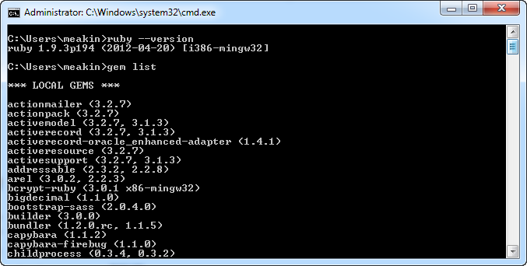
Getting the gems
Open a command prompt window and type:
“gem list”
You will see a list of all the
gems currently on your system
Look for “bundler” gem
If you do not have it, type:
“gem install bundler”
Another way to find out if you have it: in RubyMine

Slide 5
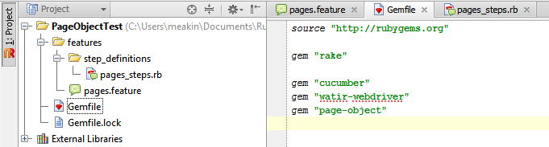
Creating a Gemfile
Once you have bundler you are ready to add your Gemfile
Right-click on the Project root directory
Goto New -> File. You should get a File Create pop-up
Name = “Gemfile”
Add the following lines to your Gemfile:
source "http://rubygems.org"
gem "rake"
gem "cucumber"
gem "watir-webdriver"
gem "page-object"

Slide 6
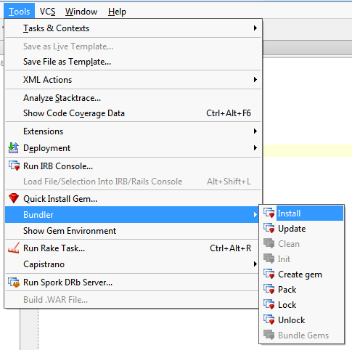
Installing the gems
If bundler is present you should be able to go to Tools ->Bundler and see numerous bundle options
Select Install
Once selected RubyMine will run the bundle install command against the list of gems in the Gemfile

Slide 7
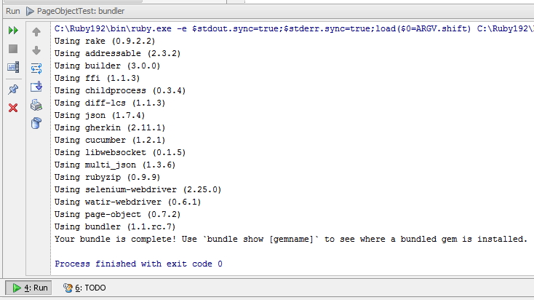
Validating you got all the gems
If all goes well you will see a Run screen that looks like this…

Slide 8
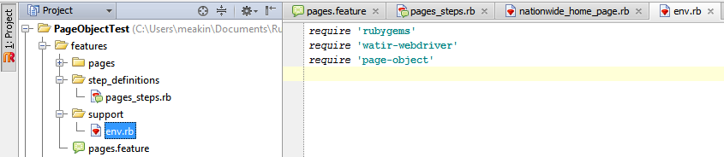
Creating the env.rb file
If you do not already have a feature/support/env.rb file you need to create one
Create a “support” directory off the “feature” directory
Create a “env.rb” file in the “support” directory
You will need to require the following gems in the env.rb file:

Slide 9
Our ToDo List
Before we dive into the code we 1st need to understand what code we need to build
Given /^navigate to the Nationwide Home Page$/ do
#ToDo: open browser
#ToDo: navigate to Nationwide Home Page
end
When /^enter Zip of “(\d+)”$/ do |arg1|
#ToDo: enter Zip Code in the Zip field
end
And /^click “Get a Quote” button$/ do
#ToDo: click the “Get a Quote” button
end
Then /^taken to the “Start Auto Quote” page$/ do
#ToDo: validate we land on the Start Auto Quote page
end

Slide 10
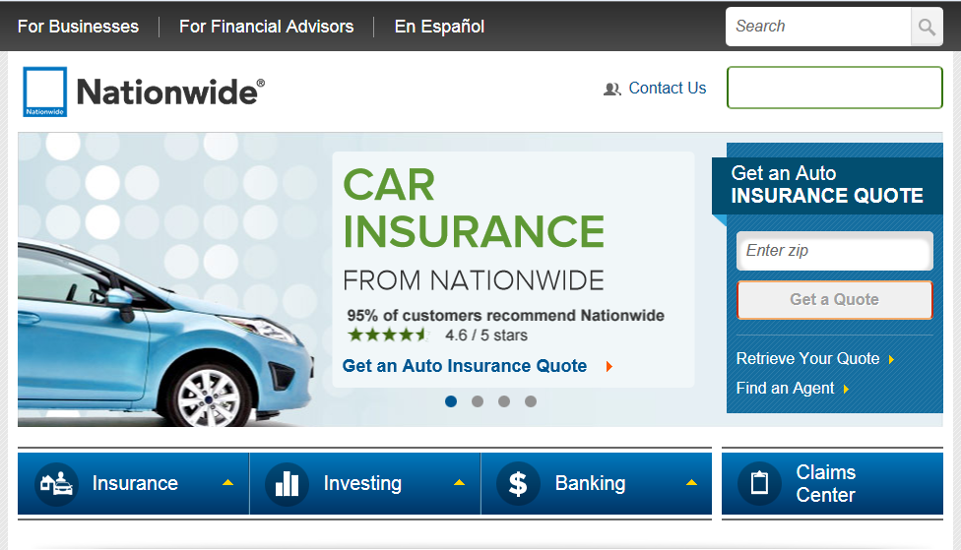
Today’s Web Page
We will be mapping “www.nationwide.com”

Slide 11
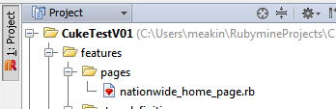
Creating the directory & Files
You want to ensure you PageObjects are kept separate from the rest of your project. Create the features/pages directory:
New->Directory: pages
Create a Class Object “NationwideHomePage”
New->Ruby Class: NationwideHomePage

Slide 12
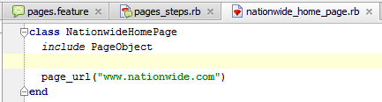
Making it a PageObject file
You must “include” the PageObject gem
class NationwideHomePage
include PageObject
You can create a page_url method
Can have one for each environment
This can tell the browser directly where to go
page_url(“www.nationwide.com”)

Slide 13
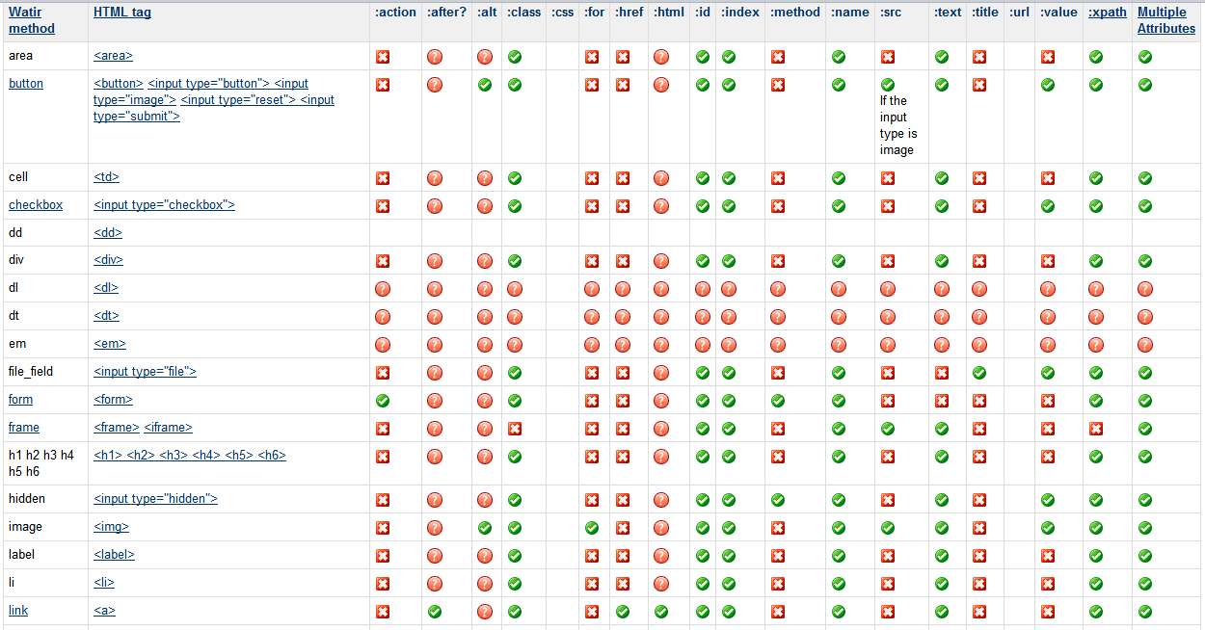
HTML Elements supported by WATiR and thus by PageObjects
Can be found at “http://wiki.openqa.org/display/WTR/HTML+Elements+Supported+by+Watir”

Slide 14
A PageObject Object
All Page Objects follow a similar naming convention:
type(:name, :attribute=>“text“)
Type is the HTML object type
your_name is the name of the object
Attribute is the HTML attribute used to identify the object
Text is the text of the attribute
Example: image(:signin_button, :name=>"Sign In“)
These are simply methods of the class
To map an object simply list it in the class object

Slide 15
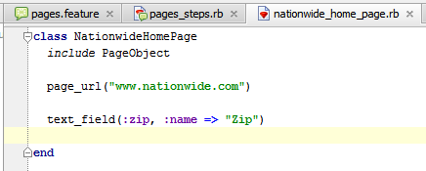
Objects you can Map: TextField
An HTML Text Field looks like this in the HTML code:
<input type=“text”>
This is how it is mapped in the class object
text_field(:zip, :name => "Zip")

Slide 16
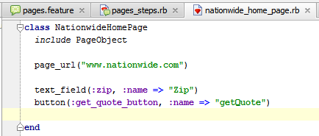
Objects you can Map: Button
Buttons
HTML: <input type=“button name=“View All”> or
HTML: <button name=“View All”>
This is how it is mapped in the class object
button(:get_quote_button, :name => “getQuote“)
Notes:
But how can we use the text field and the button?

Slide 17
PageFactory
Enables you to create PageObject objects
To add PageFactory functionality, you need the following lines in your env.rb file:
require 'page-object/page_factory‘ #loads PageFactory
browser = Watir::Browser.new :firefox #tells PageObject which browser to use
Before do #executes prior to every Scenario
@browser = browser
End
After do #executes after every Scenario
@browser.close
End
World(PageObject::PageFactory) #makes PageFactory available for the life of the run
Has only 2 methods:
visit_page – Will cause the browser to open the page specified by the call to page_url in the class
on_page – If you are already on a page and wish to interact with it you can use the on_page method
WARNING: the on_page block will be executed regardless of which page you are on

Slide 18
PageFactory – visit_page
PageObject uses the “visit_page” method to navigate to any web page
Syntax:
visit_page <PageObject class>
visit_page(<PageObject class>)
Examples: both examples will take you to the URL listed in the NationwideHomePage class object
visit_page NationwideHomePage
visit_page(NationwideHomePage)

Slide 19
Navigating through a visit_page
PageObject enables you to manipulate objects on the page you are visiting by using the “do” method
Syntax:
visit_page <PageClass> do |page|
page.<object>
end
To enter text in a text box use the “=“ method
page.<text box> = “some text”
To click a button just use it
page.<button>

Slide 20
Using visit_page
We now have all the pieces to be able to tackle our first ToDo’s
Add this code to the Given step and run
Given /^navigate to the Nationwide Home Page$/ do
#ToDo: open browser
#ToDo: navigate to Nationwide Home Page
visit_page(NationwideHomePage)
end
Expected results:
You will see a browser pop-up with a blank page
It will navigate to nationwide.com
Browser will close
If this is what you got you can remove the first ToDo’s from your list!!!

Slide 21
PageFactory – on_page
PageObject uses the “on_page” method to navigate through any web page
Syntax:
on_page <PageObject class> do |page|
page.<object>
end
Caution: Ruby interpreter will assume you are on the correct page. When it hits the on_page block it will go into it. Regardless of whether you are on it or not

Slide 22
Using on_page
We are now ready to tackle our next two ToDo’s
Add the following code to your When and And steps and Run it
When /^enter Zip of "(.*?)"$/ do |zip_code|
#ToDo: enter Zip Code in the Zip field Will get these results
on_page NationwideHomePage do |page|
page.zip = zip_code #Zip Code field populated
end
end
And /^click "(.*?)" button$/ do |button|
#ToDo: click the "Get a Quote" button
on_page NationwideHomePage do |page|
page.get_quote_button #Get Quote button clicked
end
sleep(10) #added so you can see which page
end the browser ends up on

Slide 23
Objects you can Map: Link
Links
HTML: <a href=“http://google.com”>
Listing in the class object
link(:nationwide_link , :id=>“pa1")
Use in code
#clicks the link
@page.nationwide_link
#returns the link element
@page.nationwide_link_element

Slide 24
Objects you can Map: Select List (Dropdown)
Select Lists
HTML: <select name=“repository_country”>
Listing in the class object
select_list(:directory, :name =>“repository_country“)
Use in code
#returns the value selected in the SelectList
puts @browser.directory
#sets the selected value in the SelectList
@browser.directory = “USA”
#returns the SelectList element
@browser.select_name_element

Slide 25
Objects you can Map: Image
Images
HTML: <img src=“Sogeti_Lifecycle_System_files/SignIn.gif> or
HTML: <input type=“image”>
Listing in the class object
image(:submit_button, :id=>“submit_button")
Use in code
#clicks the image
@browser.submit_button
#returns the image element
@browser.image_name_element

Slide 26
Objects you can Map: Radio Button
Radio buttons
HTML: <radio name=“consultant_type”>
Listing in the class object
radio_button(:radio_name, :name =>“consultant_type“)
Use in code
#selects the RadioButton
@browser.select_radio_name
#clears the RadioButton
@browser.clear_radio_name
#returns if the RadioButton is selected
@browser.radio_name_selected?
#returns the RadioButton element
@browser.radio_name_elements

Slide 27
Objects you can Map: Checkbox
Checkboxes
HTML: <checkbox name=“consultant_type”>
Listing in the class object
checkbox(:checkbox_name, :name =>“consultant_type“)
Use in code
#checks the CheckBox
@browser.check_checkbox_name
#unchecks the CheckBox
@browser.uncheck_checkbox_name
#returns true if the CheckBox is checked
@browser.checkbox_name_checked?
#returns the CheckBox element
@browser.checklist_name_element

Slide 28
To run Chrome
You need Chrome located at:
Google.com/chrome
You also need the chrome driver located at:
http://code.google.com/p/chromedriver/downloads/list
Download it into the c:\Ruby192\bin directory
Re-run the project with Chrome

Slide 29
Thank you

